Slide 2

Brand Health Track for Byju’s

Slide 3


Background of the study
With time, the online platforms for education started to overshadow the old-school learning processes. Everything one could learn in class can now be understood more clearly and more deeply at the convenience of the students.
Until the last decade, Organized Supplementary education was not a popular choice. In fact, the Supplementary Education sector had biases against itself. It was regarded as the go-to for weaker students. A student that survived without supplementary education was the genius.
However, with the emergence of Internet, guides, and other resources, the competition among students became fierce. A new trend emerged where a student juggling with multiple tuitions became an inspiration.
The demand for tuitions increased and various unorganized institutions started to pop-up every corner of the alley. With the reach of internet into the masses, the idea of organized online platforms became a reality which could educate the children, assist them in their career, without the student having to go outside the safe and comfort zone of their homes.
The online supplementary education was in its nascent period when the pandemic broke down in 2020. With new norms of social distancing, it was difficult for the students to continue learning. This gap was filled by online learning media. And the child now went online.

Slide 4

Need of the Study
The purpose of this study is to understand the awareness and perception of school-going students towards online modes of supplementary education. It deals with understanding the factors that affect their behavior while opting a mode of supplementary education. Further, the study deals with the brand health tracking of Byjus as an alternative to Supplementary Online Education

Slide 5
Research Objectives
1. To track brand salience and key performance indicators of Byjus Vis a Vis competition
2. To understand the shift in brand perception of Byjus Vis a Vis other competition in the online education category
3. To evaluate the key triggers and barriers of subscribing or not subscribing to Byjus online classes

Slide 6
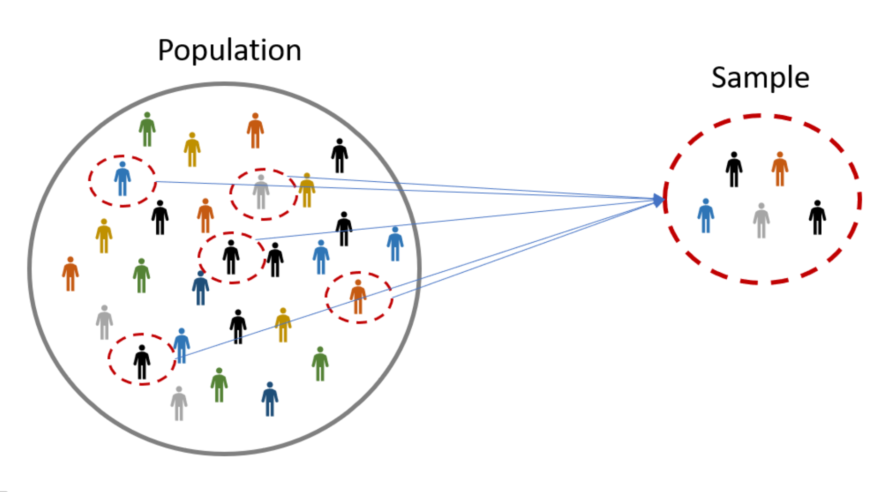
Sample Size
Population of children in India aged between 13-18 | 100,215,890 (approx.)
Confidence Level | 90%
Margin of error | 5%
Population Proportion | 50%
Sample Size required | 273
Samples Collected | 203
Sample size after filteration | 177

Slide 7
Quality filters
Some of the Process led checks would include:
Straight Liners – All ratings are for one brand
Speedsters – Time taken to complete the interview is exceptionally lower
Some of the People led checks include:
Part data Check enabling quick filtering of noise –
Inconsistency check through triangulation - Marked high on Preference & Recommendation but not even 20% of the perception is clicked for that brand
Open Ended Checks

Slide 8

Target Group
School-going Children from class 8th- 12th who can afford :
Personal Computer/Smartphone/laptop/Tablet
Supplementary education
Internet Access

Slide 9

Sample Composition

Slide 10
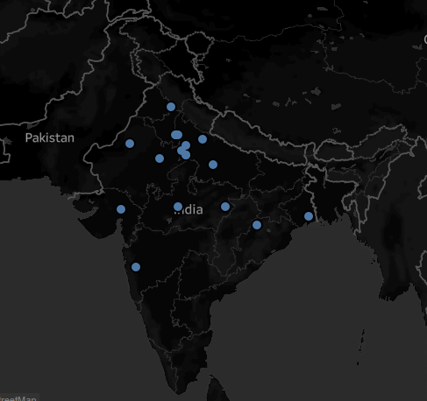
Geographical Distribution of Sample
Sample Size: 177

Slide 11
Geographical Distribution of Sample
Sample Size: 177

Slide 12

Demographics
Male: 41%
Female :58%
Sample Size: 177

Slide 13
SOCIO-ECONOMIC CLASSIFICATION
Sample Size: 177

Slide 14
Awareness of Various Platforms
Akash Institute
Physicswalla
ThinkMerit
Meritnation
AplusTopper
Unorganised Institutions
Sample Size: 177

Slide 15
There was a significant difference in awareness levels of male and female students

Slide 16
BYJU'S and Vedantu are more popular with ICSE students.

Slide 17
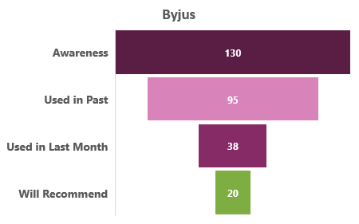
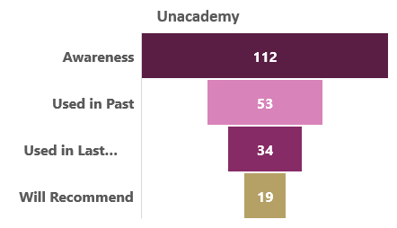
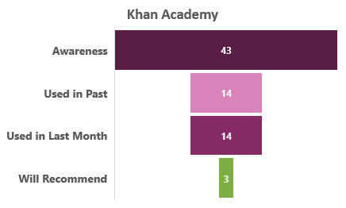
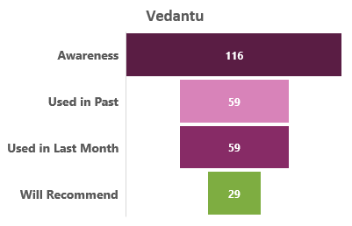
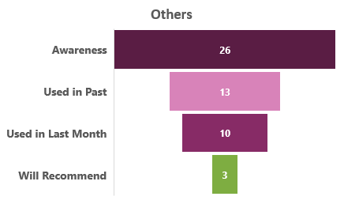
Brand Salience Funnel
Key Insights:
BYJU’s need to work towards minimizing
Awareness to usage ratio.
Sample Size: 177

Slide 18
BYJU’s usage by ICSE students was considerably high.
Sample Size: 177

Slide 19
BYJU’s is being used more by female students.
Sample Size: 177

Slide 20
ICSE is recommending our brand!
Sample Size: 177

Slide 21
Girls recommend our brand more than boys!
Sample Size: 177

Slide 22
Most Preferred Platforms
Sample Size: 177

Slide 23
While ICSE prefers BYJU’s , Vedantu is leading in CBSE.
Sample Size: 177

Slide 24
BYJU’s is preferred most by A2 class students

Slide 25
Brand Perception of BYJU’s vis-à-vis Competition
Which of the following platforms gives you the most user-friendly experience(Interface)?
Which of the following platform provides the best customer support?
Which of the following provides the most classroom-like experience?
Which of the following Platform provides the best subject material/ handouts/ notes ?
Sample Size: 177

Slide 26
Brand Imagery of BYJU’s vis-à-vis Competition
Which of the following Platform resembles the coolest teacher with modern methods of teaching (Amir Khan from "Tare Zameen Par")?
Which of the following platform resembles the most strict teacher with traditional methods of teaching?
Which of the following platform resembles the friendliest teacher to whom you can approach anytime to ask any doubt?
In case different books/ sources suggest different answers which of the following platform would you rely upon?
Sample Size: 177

Slide 27
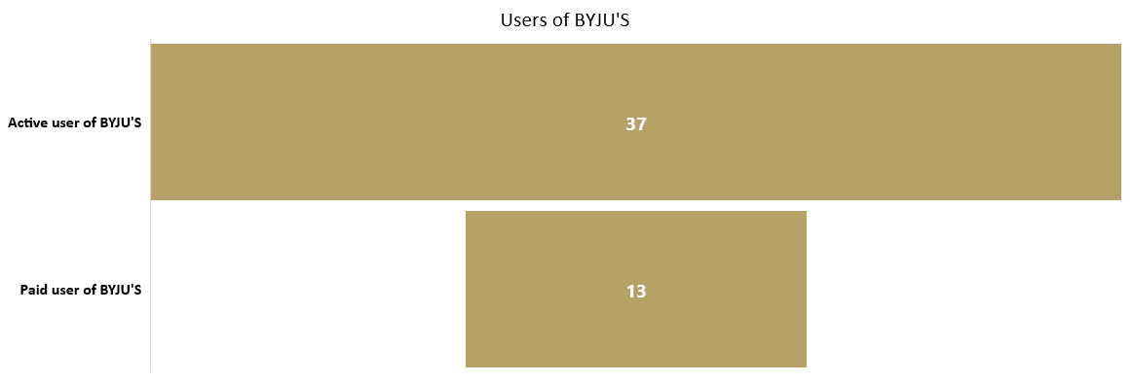
Users of Byjus
To generate increase in revenue,
there is a need to convert the unpaid users into paid subscribers.
Sample Size: 177

Slide 28
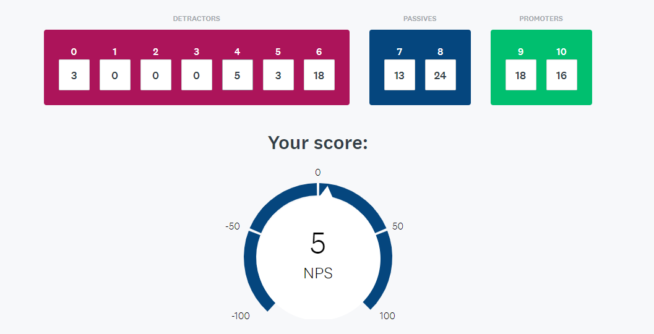
NPS Calculator
Though our brand is on the
Positive side with a good number of
Promoters, there is room for a lot of improvement.
Sample Size: 177 NPS Calculator: Find Your Net Promoter Score | SurveyMonkey

Slide 29
Triggers for BYJU’S
Quality Education- Around half of the respondents admit that the quality of BYJU’s is satisfactory
Structured Course Material
Concept Clarity-The respondents believe that the teachers of BYJU’s are able to clear the concepts

Slide 30
Barriers for BYJU’s
More than half of the respondents found the services expensive.
Aggressive marketing bids the students off
Most teachers with southern accent
Vedantu emerging as a cut-throat competition

Slide 31
Key Take Away
Need to attract the CBSE market which is the largest board in India.
Need to understand why the users are not voting the brand as most reliable.
Need to shift from Aggressive selling to Holistic Marketing.
Minimize costs to lower down the prices.
Key Target is the A1,A2,A3 socio-economic classes. B1and B2 are emerging users who could be targeted by a fall in the prices.

